Slide 1

Catálogo
Materiales para Construcción

Slide 2
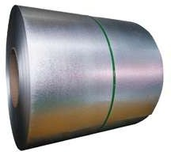
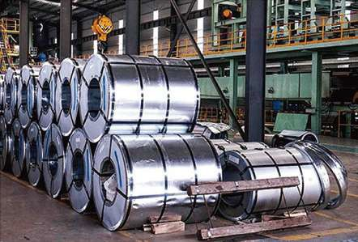
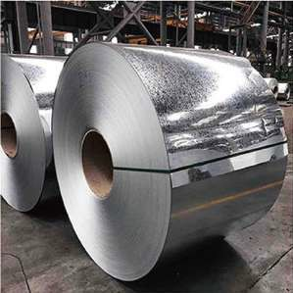
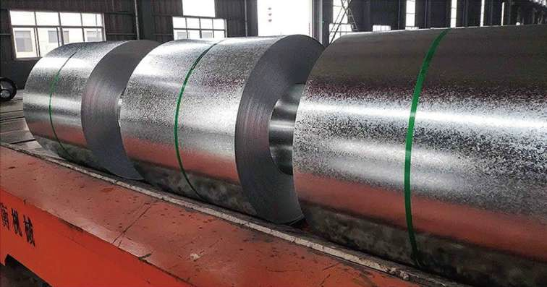
Galvanized steel coil
Galvanized Steel Coil
Grade | DX51D+Z,DX52D+ZDX53D+Z,DX54D+Z,S220GD+Z,DX51D+Z/SGCC/A653/Automotive grade,etc
Spangle coating | Big Spangle,small Spangle,Spangle-free
Surface Treatment | Passivation(C).Oiling(O).Lacquer sealing(L).Phosphating(P),Untreated(u)
Package weight | 2-6 ton per coil
Zinc Coating | 30-275g/m²
Thickness | 0.2-4.0mm
Width | 600-1250m
0

Slide 3
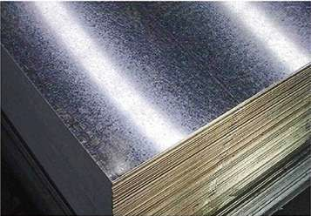
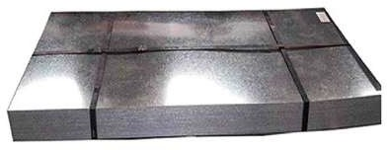
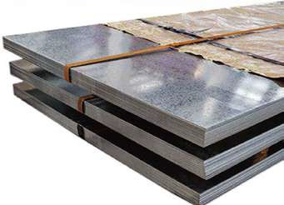
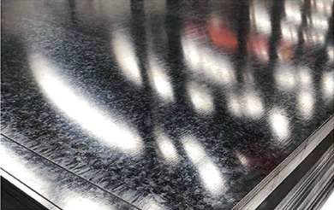
Galvanized steel plate
Name | Gl / GL / Galvanized steel sheet / Galvalume steel sheet
Standard | ASTM，DIN,JIS，BS，GB/TGB，EN
Grade | CGCC，CGCH，G550，DX51D，DX52D，DX53D, all according to the customer's request
Applicantion | Villas ,townhouse, apartments ,tourist destination building ,and roof conversion project
Thickness | 0.12-4.0 mm BWG / AWG or as your request
Width | 20-1500 mm or as your request, Normal width is 914/1000/1219/1250/1500 mm
Zinc coating | 30~600 G/M²
Spangel | Regular spangleMinimum spangle, Zero spangle, Big spangle
Surface treatment | Chromated/Non.Chromated diled/Non.oiled. skin pass
Package | Waterproof paper plastic film & iron packing bunding. or as customer's reauirement
Instruction | Galvanized steel is mild steel with a coatina of zinc The zinc protects the steel by providing cathodic protection to the pynosed steel. so should the surface be damaged the zinc will witcorrode in preference to the steel.
04

Slide 4
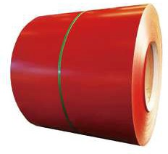



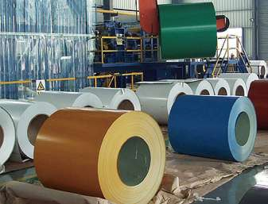
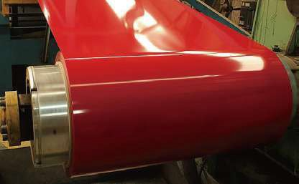
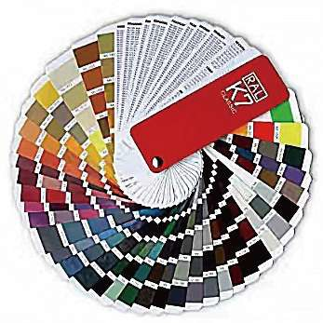















PPGI
PPGI/PPGL Galvanized Steel Coil
Standard | ASTM,JIS, EN, DIN.GOST, GB, etc.
Grade | SGCC.,SECC,SGCH.DX51D+Z/DX53D+Z/S220GD-550GD
Thickness | 0.13-0.70mm
Width | Max1250mm(600-1250mm)
Length | By coil
Base material | GI,GL
Zinc Coating | 40g/m² to 275g/m²
Painting Thickness | Top side: 10-25microns; Back side: 3-20microns
Colour | RAL NO./Your sample
Coil iD | 508mm/610mm
Packing | Wateroroof paner+plastic fiim+iron nackina+bundling. or as per customers request
Application | Corrugated rofing sheet. Celing channel, industrial retrigeration,cold storage, door panel,sandwich panel,PU panel.
Prepainted Color steel Coil/Sheet
Prepainted color prinhne coil/plate
Prepainted color matte coil/plate
05

Slide 5
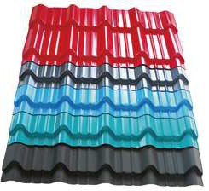
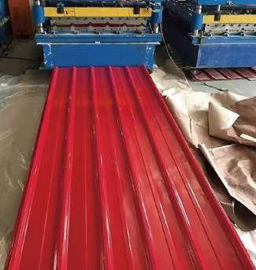
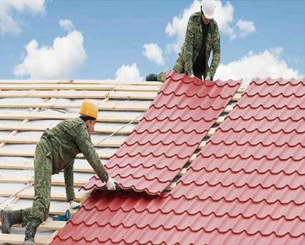
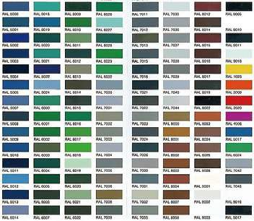
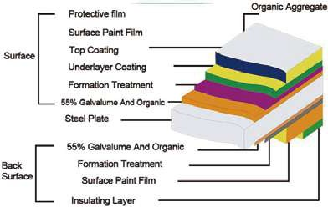
Color coated corrugated plate
Corrugated Galvanized Roofing Sheet
Material | SGCC.DX51D.DX53D,DX54D,SPHC,Q195 etc
Type | Corugated Sheets
Thickness | 0.12mm-0.8mm,according to your requirement
Width | 600mm-1500mm, according to your requirement
Zinc Coating | 30-500g/m²
Color Choice | Any of the available color
Standard | ASTM, BS, GB, JIS,etc
Surface | Finished or unfinished is available, coat or without coat
Application | Widely used in construction,home,appliance,decoration,wear resistant steel,etc.
Color coated roof/wall sheet surface
Protective ﬁlm
Surface Paint Film Top Coating Underlayer Coatin
Organic Aggregate
Surface
g
Formation Treatment
55% Galvalume And Organic
Steel Plate
55% Galvalume
And Organic
Back Surface
Formation Trea
tmen
t
Surface Paint Film
Insulating Layer

Slide 6

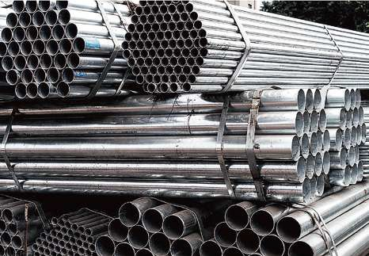
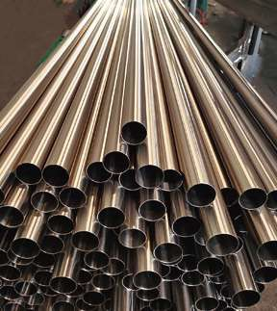
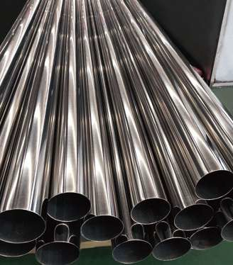
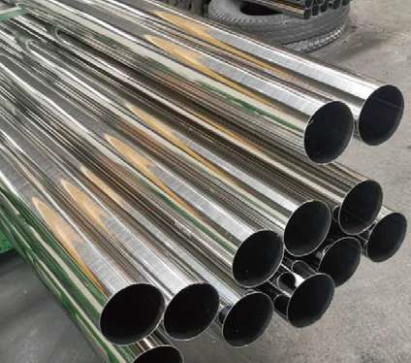
Stainless steel pipe
Stainless steel tube/pipe
Standard | ASTM A213.A312.ASTM A269ASTM A778ASTM A789.DIN 17456.DIN17457.DIN 17459.JIS G3459. JIS G3463.GOST9941EN10216.BS3605
Place of Origin | Shandong, China
Type | Seamless
Steel Grade | 200 series: 201,202,202Cu,204Cu. 300series: 301,303/Cu,304/L/H,304Cu,305,309/S,310/S,316/L/H/Ti,321/H,347/H,330, 400 series:409/L410,416/F420/F430，431，440C，441，444，446， 600 series:13-8ph,15-5ph,17-4ph17-7ph(630631)660A/B/C/D， Duplex: 2205(UNS S31803/S32205),2507(UNS S32750),UNS S32760.2304,LDX2101.LDX2404，LDX4404,904L
Application | Construction,machine structure pipe, Agriculture equipment pipe, Water and gas pipe, Greenhouse pipe， Scaffolding pipe, Building material tube, Furniture tube, Low pressure fluid tube, Oil pipe, etc

Slide 7
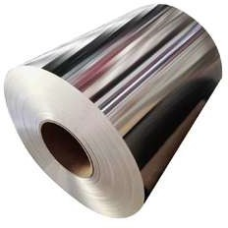
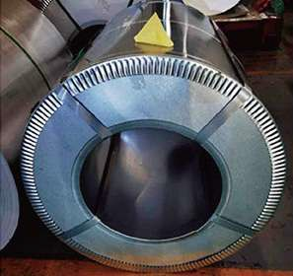
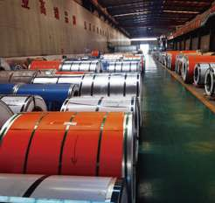
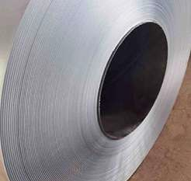
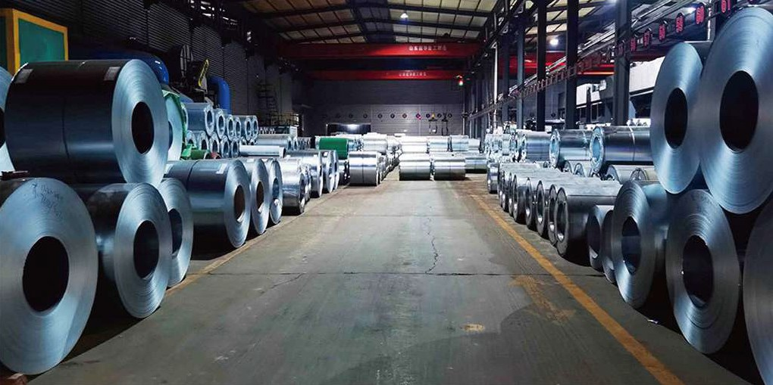
Stainless Steel Coil
 | Stainless Steel Coil
 | Standard | JIS,AISI,ASTM,DIN,EN,GB
 | Material | 200 series;201 202.cte 300series;301 304 304L 309 310 310s 316 316L 321,cte 400 series;409 410 410S 420 430,cte
 | Surface | 2B,BA(bright annealed)NO.1 NO.2 NO.3 NO.4,8K HL(Hair Line)PVC
 | Technique | Hot Rolled/Cold rolled
 | Thickness | Cold rolled 0.4mm-3.0mm,Hot Rolled3.0-100mm or as required
 | Width | 24-2000mm or as required
 | Lengtn | 1-6m or as required
 | Coil Weight | 3.5-5 ton for nomal standard or as coustomer’s request
 | Application | construetion firld,ships building industry,potroloum&chernical industries,war and electricity industries,food processing and medical industry
 | Protection | 1.Inter paper available 2.PVC protecting film available
 | Features | (1)High temperature strength and high temperature ptasticity(2)Has excellent oxidation resistance and corrosion resistance (3)Has good tissue stability(4)Unitorm chemical composition(5)Has good precessability and welding pertormance (6)High dimensional accuracy and surface quality
INGENUITY AND QUALITY

Slide 8
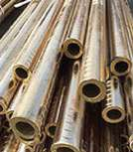
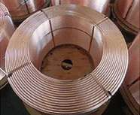
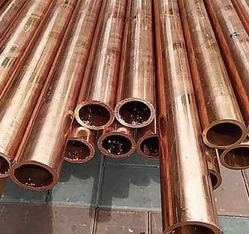
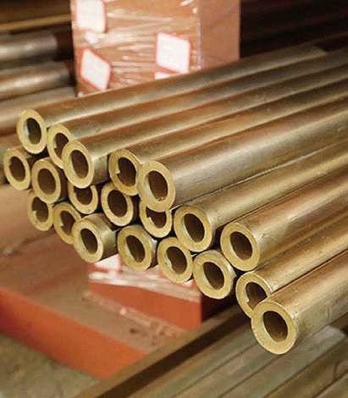
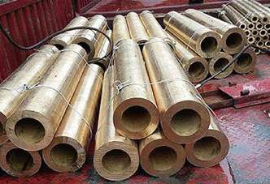
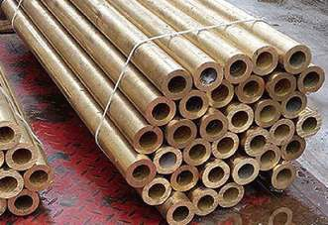
Hecho de cobre puro o aleación de cobre en diversas formas, incluidas varillas, alambres, placas, tiras, tiras, tubos, láminas, etc., denominados colectivamente cobre. Los materiales de cobre incluyen placas de cobre, varillas de cobre, tubos de cobre, tiras de cobre y alambres de cobre. barras de cobre, materiales de cobre.
Copper pipe
Air Conditioning stralcntluoes
Thickness O.D | 0.30 mm | 0.35 mm | 0.40 mm | 0.45 mm | 0.50 mm | 0.55 mm | 0.60 mm | 0.65 mm | 0.70 mm | 0.75 mm | 0.80 mm | 1.00 mm | 1.20 mm | 1.50 mm
4.76(3/16in)
6.00
6.35(1/4in)
7.00
7.94(5/16in)
8.00
9.52(3/8in)
10.00
12.00
12.70（1/2in）
14
15
15.88(5/8in)
16
19.05(3/4in)
22.22（7/8in）
25.4（1in）
28.57(1-1/8in)
Remark: | Sizos with mark‘ ’indicate chase are common sizes which the factory is marking, Any unusual sizes with special requirement can be tailor-made against order.

Slide 9
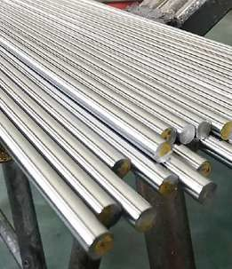
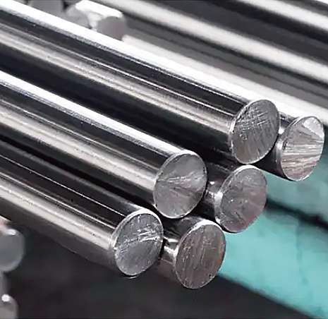
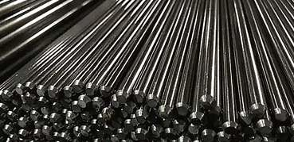
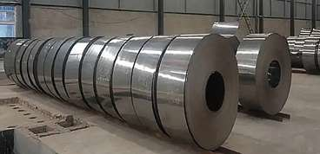
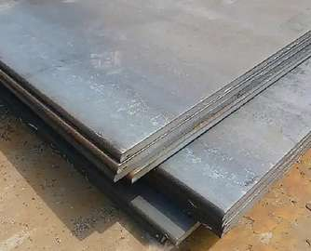
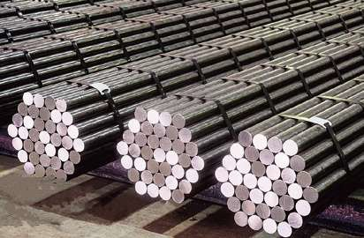
Alloy structural steel
Allov Steel For Structural Use
牌号 | C | Si | Mn | S | P | Cr | Mo | Ni | 其他元素 Othere Elements
15Cr | 0.12-0.18 | 0.12-0.18 | 0.40-0.70 | 0.015max | 0.025max | 0.70-1.00
20Cr | 0.18-0.24 | 0.17-0.37 | 0.40-0.70 | 0.015max | 0.025max | 0.70-1.00
40Cr | 0.37-0.44 | 0.17-0.37 | 0.37-0.44 | 0.015max | 0.025max | 0.80-1.10
15CrMo | 0.12-0.18 | 0.17-0.37 | 0.40-0.70 | 0.015max | 0.025max | 0.80-1.10 | 0.40-0.55
20CrMo | 0.12-0.18 | 0.17-0.37 | 0.40-0.70 | 0.015max | 0.025max | 0.80-1.10 | 0.15-0.25
30CrMo | 0.26-0.34 | 0.10-0.30 | 0.40-0.70 | 0.015max | 0.025max | 0.80-1.10 | 0.15-0.25
35CrMo | 0.32-0.40 | 0.17-0.37 | 0.40-0.70 | 0.015max | 0.025max | 0.80-1.10 | 0.15-0.25
34CrMo4 | 0.30-0.37 | 0.40max | 0.60-0.90 | 0.015max | 0.025max | 0.90-1.20 | 0.15-0.30
42CrMo4 | 0.38-0.45 | 0.40max | 0.60-0.90 | 0.015max | 0.025max | 0.90-1.20 | 0.15-0.30
SNCM220 | 0.17-0.23 | 0.15-0.35 | 0.60-0.90 | 0.015max | 0.025max | 0.40-0.65 | 0.15-0.30 | 0.40-0.70
H42B | 0.37-0.45 | 0.17-0.37 | 0.70-1.00 | 0.015max | 0.025max | 0.025max |  | 0.20max
20Mn5 | 0.17-0.23 | 0.40max | 1.10-1.40 | 0.015max | 0.025max |  |  | 0.20max | 0.0008-0.0050（B）
26Mn5 | 0.23-0.28 | 0.40max | 1.10-1.40 | 0.015max | 0.025max | 0.10-0.20 |  | 0.20max | 0.0008-0.0050（B）
27MnCrB5 | 0.24-0.30 | 0.40max | 1.10-1.40 | 0.015max | 0.025max | 0.40max |  | 0.20max | 0.0008-0.0050（B）
40MnB | 0.37-0.44 | 0.17-0.37 | 1.10-1.40 | 0.015max | 0.025max |  |  |  | 0.0008-0.0050（B）
16MnCr5 | 0.14-0.19 | 0.40max | 1.00-1.30 | 0.015max | 0.025max | 0.80-1.10
20CrMnTi | 0.17-0.23 | 0.17-0.37 | 0.80-1.10 | 0.015max | 0.025max | 1.10-1.30 |  |  | 0.04-0.10(Ti)
40CrMn | 0.37-0.45 | 0.17-0.37 | 0.90-1.20 | 0.015max | 0.025max | 0.90-1.20
50Mn2V | 0.48-0.57 | 0.30max | 1.40-1.80 | 0.015max | 0.025max | 0.30max |  |  | 0.08-0.16(V)

Slide 10
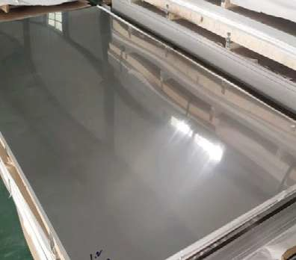
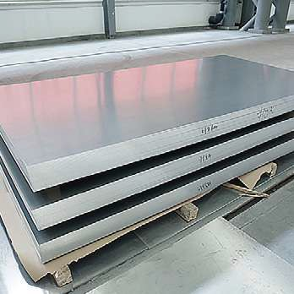
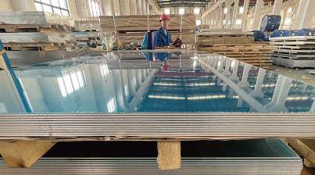
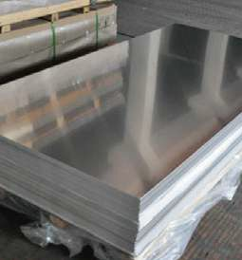
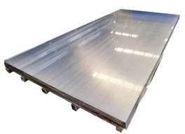
Aluminum plate
Aluminum Plate
Thickness | 0.2mm-600mm
Width | 20mm-2650mm
Lengih | As customer's requirements
Temper | O,H,T
Surface | Flat every pieces covered with PE fim
Packing | Export standard woodon pallots (as per requiremonts)
Features | 1) Easy installation 2) High strength 3) Low in costs 4) Durable 5) Nice appearance 6) Anti oxidation
Application | 1) building and construction 2) decoratian 3) curtain wall 4) Shelter 5) oil tank 6) mould,ect.
Grade | 1050106010702A16/2006/300330043A211 4A015052/6061,ect..
Delivery time | 20-30 days after receivina LC or deposit
Loading Port | Qingdao, China (any port in China )
Remark | Specific requirement of allay grade,temper or specification can be discussed at your request
11

Slide 11
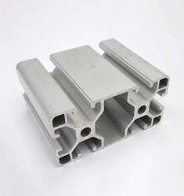
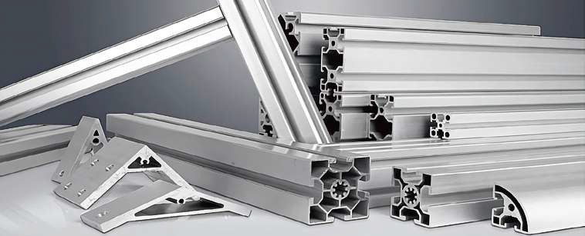
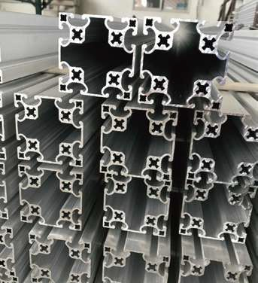
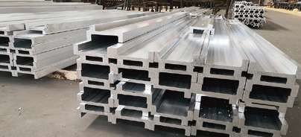
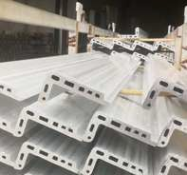
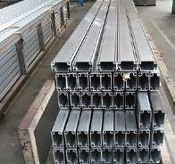
Aluminum profile
Aluminum profile
Aluminum alloy | 6051/6063 aluminium alloy
Temper | T4.T5.T6
Tandard | GB5237.1-2017
Surface treatment | Mill finish; Anodized: sandblasting: Polishing: Powder Coated: PVDF: Coating: Wood transfer, etc.
Color | Customized
Thickness | Customized
Delivery time | 8-25 days
Payment terms | 30% deposit 70% balance before shipping by T/T: L/C at sight
Advantage | Have factory customized varlous aluminum profles, accessories, and installation
12

Slide 12
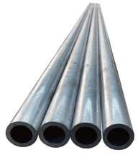






Aluminum Pipe
Aluminum Pipe/tube
Standard | ASTM、JIS、GB、EN、DIN、GB/T 3880-2012、GB/T5237.1-2008. GB/T4437.1-2000、GB/T6893-2000
Material | 1050、1060、3003、5052、2011、2024、2A12、3A21、6061 6063、6068、7075、LY12、7005 andso on
Type | Seamless aluminum tubes, common extruded tubes
Length | 1000mm、2440mm、3000mm、6000mm or customized
Outside Diameter | 4-300mm
Thickness | 0.25-40mm
Application | Used in automobile, ship, aerospace, aviation, electricalappliances, agriculture, electromechanical, household andotherindustries

Slide 13






Aluminum Coil
Aluminum Coil
Standard | ASTM、JIS、GB、DIN、EN
Material | 1060、1100、2A16、2A06、3003、3004、3A21、4A01、5052.5005、5083、 5A05、6061、7075、8011 and so on
Type | 1000-9000 9 series
Width | 15-2000mm
Thickness | 0.2-15mm
Application | Used in electronics, packaging, construction, machinery,etc.

Slide 14





Aluminum Bar
Aluminum Bar
Standard | ASTM、GB、JIS、EN、DIN、GB/T 3191-2010
Material | 1050、1060、1100、2A16、2A02、T3、T4、T351、3003、3A214A01、5052、 5005、5083、5A05、6061、6063、7075 and so on
Type | Round aluminum rods, square aluminum rods, hexagonal aluminum rods, etc.
Length | 1000mm、2000mm、3000mm or customized
Diameter | 5-200mm
Application | Used in decoration, packaging, construction,transportation, electronics, aviation, aerospace, weaponsand other industries

Slide 15





Aluminum Foil
Aluminum Foil
Standard | ASTM、JIS、GB、DIN、EN
Material | 8011、1235、1060、3003、1100
Type | Heavy gaugefoil.Medium gauge foil, Light gauge foil
Technology | Rough rolling, Medium rolling, Finishingrolling
Thickness | Heavy gaugefoil: 0.1-0.2mm; Medium gauge foil:0.01-0.1mm; Light gauge foil: 0.005-0.009mm
Commonly Used Types | Air conditioning foil, cigarette packaging foil, decorativefoil, cable foil

Slide 16







Aluminum Flat Bar
Aluminium Flat Bar
Standard | GB、JIS、ASTM、EN、DIN、GB/T 5585.2-2005
Material | 1050,1060,1070,1100,1200,2A21,3003,5052,5083,6061. 6082,8011,etc.
Width | 20-200mm
Length | 20-300mm
Thickness | 0.35-1.5mm
Application | Widely used in building profiles, irrigation pipes, pipes, rods and profiles for vehicles,benches, furniture,lifts and fences，etc.

Slide 17






Steel Rebal
Steel Rebar
Standard | JIS、ASTM、GB、EN、GB1499,2-2007、XG1-2009、 GB1499.1-GB1499.3、JIS G3112-87、BS4449-97
Material | HRB335、HRB400、HRB500
Length | 3500-12000mm
Diameter | 6-50mm
Tolerance | 6-12mm;土7%;14-20mm: 土5%;22-50mm: 土4%
Application | Widely used in civil engineering construction of houses, bridges, roads, etc.
INGENUITY AND QUALITY
18

Slide 18








Carbon steel plate
Carbon steel sheet
Standard | GB/T700 standard:Q235A,Q235B.Q235C,Q235D,Q235E EN10025 standard :S235JRS235J0S235J2 DIN 17100 standard : St33,St37-2Ust37-2RSt37-2,St37-3 DIN 17102 standard: StE255.WstE255.TstE255.EstE255 ASTM standard :A36/A36M A36 A283/A283M A283 Grade AA283 Grade B A283 Grade C,A283 Grade D A573/A573M A573 Grade 58, Grade 65,Grade 70
Material | Carbonsteel:Q195Q420SeriesSS400-SS540 Series. S235JR-S355JR Series,ST Series,A36-A992 Series,Gr50 Series,etc.
Surface | Mild steel plain finish, hot dip galvanized, color coated, etc.
Package | Export standard package: bundled wooden box or be required; The inner size of container is below: (1)20 foot GP: 5.8m(length)x 2.13m(width)x 2.18m(high) about 24-26 CBM(2)40 foot GP:11.8m(length)x 2.13m(width)x 2.72m(high) about 68 CBM We will packing as the factory,and reach the stander of export. Or as the customer request. In addition. We will make the products with good surface protection.
Application | Wear-resistant steel with high wear resistance and good impact performance. capable of cutting, bending, welding, etc., can be taken welding, plug welding. bolting and other ways to connect with other structures, with the province when in the course of the repair site , convenient, widely used in metallurgy, coal, cement, electricity glass, mining, building materials, bricks and other industries compared with other materials.
19

Slide 19







Carbon steel coil
Carbon Steel Coil
Standard | AiSi,ASTM.bs.DIN,GB,JIS,etc
Grade | A36 Grade50/SS400/Q235/Q345B/Q460/Q195/SPCC-SD/ST13/DC01，etc
Tolerance | ±1%
Thickness | 0.12MM-18MM
Width | 1250-2000MM
Length | 1250-11800MM
Coil Weight | 3~10Tons
Surface Treatment | Normal Black Surface
Technique | Cold Rolled/Hot Rolled
Certification | IS09001/BV/SGS/CE，etc
Application | Building,Material/Container,Plate/Structural,use/roofing/corrugated,roofing/commercial. use/household.appliance/industry.
20

Slide 20




Section steel
H Beam Specification
size | w/m | size | w/m | size | w/m
1100*505*7 | 9.54 | 250*255*14*14 | 82.2 | 400*400*13*21 | 172
100*100*68 | 17.2 | 294*200*8*12 | 57.3 | 400*408*21*21 | 197
125*6068 | 13.3 | 300*1506.5*9 | 37.3 | 414*405*18*28 | 233
125*125*6.5*9 | 23.8 | 294*302*1212 | 85 | 440*300*11*18 | 124
148*10069 | 21.4 | 300*3001015 | 194.5 | 446*199*7*11 | 66.7
15075*5*7 | 14.3 | 3003徙0515*15 | 106 | 450*200*9*14 | 76.5
150150*7*10 | 31.9 | 338351*13*13 | 106 | 482*300*11*15 | 115
1759058 | 18.2 | 340*250*9*14 | 79.7 | 488*300*11*18 | 129
175*175*7.5*11 | 40.3 | 344*354*16*16 | 131 | 496199*9*14 | 79.5
194*150*69 | 31.2 | 346174*69 | 41.8 | 50020010*16 | 89.6
19899*4.5*7 | 18.5 | 3501757*11 | 50 | 582*300*1217 | 137
200*100*5.5*8 | 21.7 | 344*348*10*16 | 115 | 5883001220 | 151
200*200*8*12 | 50.5 | 35035012*19 | 137 | 596*199*10*15 | 95.1
200*204*12*12 | 72.28 | 388*40215*15 | 141 | 600*200*11*17 | 106
244*175*711 | 44.1 | 390*3001016 | 107 | 700*30013*24 | 185
244*252*11*11 | 64.4 | 394*398*11*18 | 147 | 792*300*14*22 | 191
248124*5*8 | 25.8 | 4001508*13 | 55.8 | 800*3001426 | 210
250125*6*9 | 29.7 | 396*199*7*11 | 56.7 | 900*300*16*28 | 243
Grade | Q235.Q345.SS400.SS490.S235/S275.A36.A992.A572gr50
H*B | 100*100-900*300mm
T1 | 7-35mm
T2 | Hot Rolled
Technique | AiSi,ASTM.bs.DIN,GB,JIS,etc
Application | Mechanical&manufacture,Steel structure,Ship building Bridging,Automobile chassis
MOQ | 20 Metric Ton/Metric Tons
Packaging Details | Bundled with firm steel straps, easy for loading

Slide 21





Round steel
Round Bar
Diameter(mm) | Theoretical weight(kg/m) | Diameter(mm) | Theoretical weight(kg/m)
5.5 | 0.186 | 13 | 1.04
6 | 0.222 | 14 | 1.21
6.5 | 0.26 | 15 | 1.39
7 | 0.302 | 16 | 1.58
8 | 0.395 | 17 | 1.78
9 | 0.499 | 18 | 2
10 | 0.617 | 19 | 2.23
11 | 0.746 | 20 | 2.47
12 | 0.888 | 21 | 2.72
22 | 2.98 | 63 | 24.5
23 | 3.26 | 65 | 26
24 | 3.55 | 68 | 28.5
25 | 3.85 | 70 | 30.2
26 | 4.17 | 75 | 34.7
27 | 4.49 | 80 | 39.5
28 | 4.83 | 85 | 44.5
29 | 5.18 | 90 | 49.9
30 | 5.55 | 95 | 55.6
31 | 5.92 | 100 | 61.7
32 | 6.31 | 105 | 68
33 | 6.71 | 110 | 74.6
34 | 7.13 | 115 | 81.5
35 | 7.55 | 120 | 88.8
36 | 7.99 | 125 | 96.3
38 | 8.9 | 130 | 104
40 | 9.86 | 140 | 121
42 | 10.9 | 150 | 139
45 | 12.5 | 160 | 158
48 | 14.2 | 170 | 178
50 | 15.4 | 180 | 200
53 | 17.3 | 190 | 223
55 | 18.6 | 200 | 247
56 | 19.3 | 220 | 298
58 | 20.7 | 250 | 385
60 | 22.2
INGENUITY AND QUALITY
22

Slide 22







Seamless steel tube
Product Name | Seamless steel tube
Standard | DIN2391,EN10305,ASTM A519, GB/T 3639-200
Material | Q355B Q355D C20,ST52E355 SAE1026.CK45 4130 4140 STKM 13C
Heat treatment | BK+S
Grade | Outer diameter(mm) : 40-480mm
Specification | H8-H9
I.D Tolerance | Fixed Length, Random Length(3--9m)or as requests of customers
Length | 0.5-1/1000
ID roughness | RA 0.1-0.8micron(max)
Payment term | FOBCFR, CIF EXW. FCA and so on
MOQ | 3 tons
Technology | Honed & SRB(SKIVED AND ROLLER BURNISHED )
Application | hydraulic cylinder, swivel crane, injection machine and so on
Conservation | anti rust oiled inside and outside surface, plastic caps in both ends
Package | bundle with steel strip and knitting strip, or wooden case

Slide 23






welded steel pipe
Product Name | welded steel pipe
O.D | 6-720mm
Wall Thickness | 1.2-30mm
Length | 4-12m
Material | Q235A, Q235B,Q345, L245,L290, API5L X42,X52,X60,X70,X80. OCr13.1Cr17.00Cr19Ni11.1Cr18Ni9.0Cr18Ni11Nb.ST37.0. ST35.8,ST37.2.ST45,ST52,ST52.4.STP G38,STP G42STPT42,STS49, etc...
Standard | SY/T5037-2000.GB/T9711.1-1997,GB/T9711.2, API-5L,SY/T5040-92ASTM A53,A106, DIN1626,DIN1629,DIN2448JIS G3452,JIS G3454,JIS G3455,JIS G3456.JIS G3457.JIS G3461
Application | Mainly used in water engineering, petroleum and natural gas industry, chemicalindustry, agricultural irrigation, urban construction,

Slide 24







Packaging & transportation
25

Slide 25







Factory display
26

Slide 26

ventas@magentachile.cl
Magentachile.cl

